Slide 1
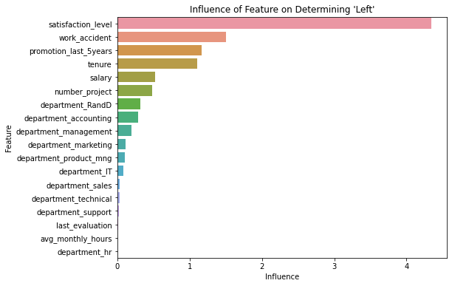
Salifort Motors Employee Retention
Factor Affecting Employee Retention
Project Overview
This project is regarding employee retention and the reasons employees are leaving Salifort Motors.
Data collected from a survey sent by HR to employees
A logistic regression model was created to determine which factor has the greatest impact on employee retention
satisfacation_level has the greatest impact on employee retention. It is much more impactful than the second highest feature, work_accident.
Find ways to increase employee satisfaction
Find the highest impactful factor while disregarding satisfaction to see what else influences employee retention

